Slide 1

Financial Accounting
Dr.Smita Jape
Associate Professor
DR.V.N.BRIMS

Slide 2
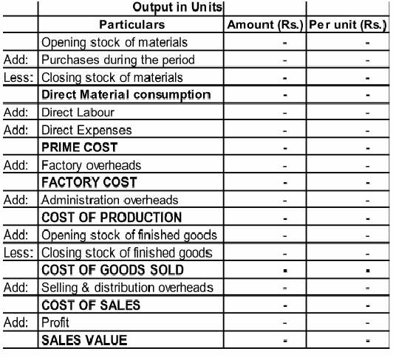
Cost Sheet Format

Slide 3
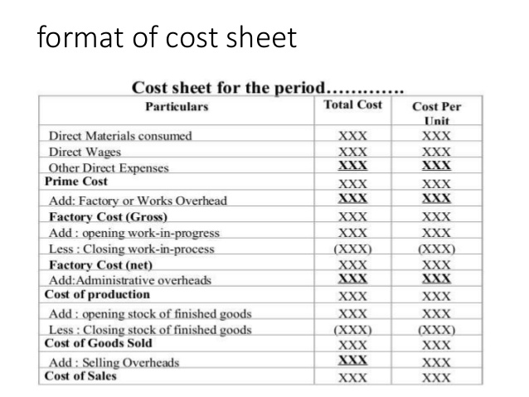

Slide 4
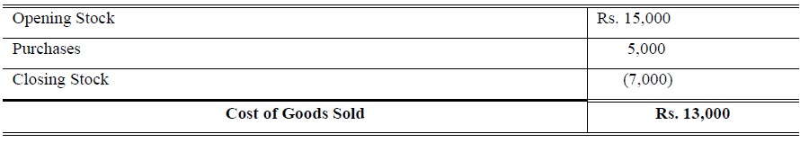
Ascertain Cost of Goods Sold from the following figures:
Purchases Rs. 5,000; Opening Stock Rs. 15,000; Closing Stock Rs.7,000.

Slide 5
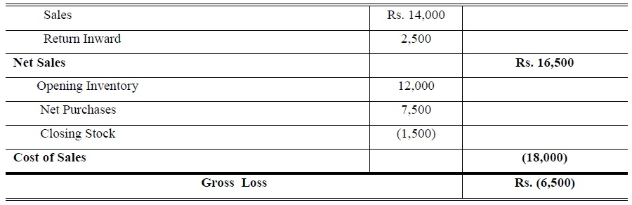
Cost of sales
Ascertain Gross Profit / Loss form the following figures:
Closing Stock Rs. 1,500; Sales Rs. 14,000; Opening Inventory Rs. 12,000; Net Purchases Rs. 7,500; Rs. Return Inward Rs. 2,500.

Slide 6
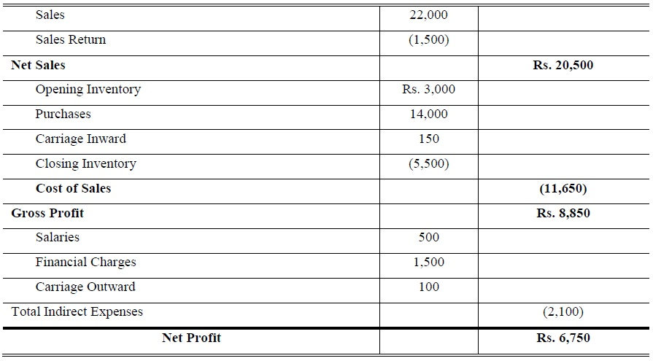
Cost of Sales
From the following information extract Gross Profit and Net Profit:
Opening Inventory Rs. Rs. 3,000;
Purchases Rs. 14,000; Sales Rs. 22,000; Closing Inventory Rs. 5,500;
Sales Return Rs. 1,500; Salaries Rs. 500; Financial Charges Rs. 1,500;
Carriage Inward Rs. 150; Salaries Outstanding Rs. 400 ;
Carriage Outward Rs. 100.

Slide 7
From the following information extract Gross Profit and Net Profit:
Opening Inventory Rs. Rs. 3,000; Purchases Rs. 14,000; Sales Rs. 22,000; Closing Inventory Rs. 5,500; Sales Return Rs. 1,500; Salaries Rs. 500; Financial Charges Rs. 1,500; Carriage Inward Rs. 150; Salaries Outstanding Rs. 400 ; Carriage Outward Rs. 100.

Slide 8
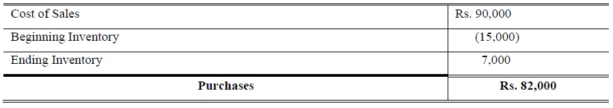
Purchases
3. Ascertain Purchases from the following figures:
Cost of Sales Rs. 90,000; Ending Inventory Rs. 7,000; Beginning Inventory Rs. 15,000.

Slide 9
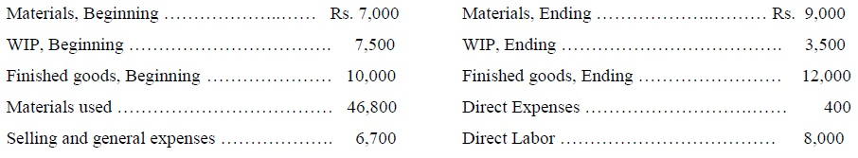
Problem # 1:
These data relate to Zakar Co.’s July 2017 operations:
Factory overhead is applied at the rate of 80% of direct labor cost.

Slide 10
Requirement:
Cost of materials purchased, Cost of goods manufactured, Cost of goods sold and Conversion Cost.
Solution:
ABC Ltd Company
Cost of Goods Sold Statement
For the Ended July, 2017
Conversion Cost = Direct Labor + FOH
= 8,000 + 6,400 = Rs. 14,400

Slide 11
Opening Inventory |  | 7,000
Net Purchases (Calculated) |  | 48,400
Direct Expenses |  | 400
Material Available for use |  | 55,800
Closing Inventory |  | (9,000)
Direct Material used |  | 46,800
Direct Labor (80% of direct labor cost) |  | 8,000
Prime Cost |  | 54,800
Factory Overhead Cost |  | 6,400
Total Factory Cost |  | 61,200
Opening Work in Process |  | 7,500
Cost of Goods Available for Manufactured |  | 68,700
Closing Work in Process |  | (3,500)
Cost of Goods Manufactured |  | 65,200
Opening Finished Goods |  | 10,000
Cost of Goods Available for Sold |  | 75,200
Closing Finished Goods |  | (12,000)
Cost of Goods Sold |  | Rs. 63,200

Slide 12
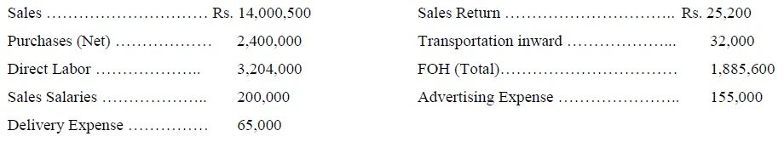
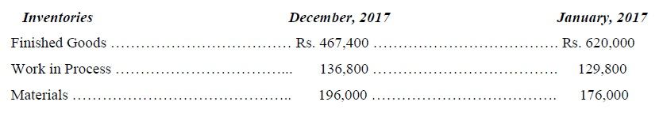
Problem # 2:
Following are data Extracted from Mr xyz Ltd. at the end of December 31
During the year 25,000 units were completed.
Requirements:
(1) Total Factory Cost
(2) Cost of Goods Manufactured
(3) Cost of Goods Sold
(4) Gross Profit and Net Profit
(5) Per Unit Cost of Goods Manufactured

Slide 13
Opening Inventory |  |  | 176,000
Net Purchases |  |  | 2,400,000
Transportation inward |  |  | 32,000
Material Available for use |  |  | 2,608,000
Closing Inventory |  |  | (196,000)
Direct Material used |  |  | 2,412,000
Direct Labor |  |  | 3,204,000
Prime Cost |  |  | 5,616,000
Factory Overhead Cost |  |  | 1,885,600
Total Factory Cost |  |  | 7,501,600
Opening Work in Process |  |  | 129,800
Cost of Goods to be Manufactured |  |  | 7,631,400
Closing Work in Process |  |  | (136,800)
Cost of Goods Manufactured |  |  | 7,494,600
Opening Finished Goods |  |  | 620,000
Cost of Goods to be Sold |  |  | 8,114,600
Closing Finished Goods |  |  | (467,400)
Cost of Goods Sold |  |  | Rs.7,647,200

Slide 14
Solution:
XYZ Pvt. Ltd.
Cost of Goods Sold Statement
For the Ended December, 2017
Gross Profit = Net Sales – CGS =
(14,000,500 – 25,200) –7,647,200 = Rs. 6,328,100
Net Profit = Gross Profit – Indirect Expenses
6,328,100 – (200,000 + 65,000+155,000)
= Rs. 5,908,100
Per unit Cost of goods manufactured =
7,494,600 /25,000 = Rs. 300 Per Unit

Slide 15
Problem # 3:
Account Department of the ABC Co. provides the following data at end of June 2017, you are required to prepare 1
Cost of Goods Manufactured;
2 Cost of Goods Sold;
3find out Gross Profit / Loss &
4 Net profit / Loss and
5Per unit Manufacturing Cost at the Year ended May 30th, 2009,
assuming that Net Sales of Rs. 72,000, Marketing Expense 5%, Advertising Expense 1 % and Other Expense 3% of Net Sales; Net Purchases Rs. 36,000 and Direct Expenses are 1 % of Net Purchases; FOH 2/3 of Direct Labor and Direct Labor cost is Rs. 15,000. Units are produced during the period was 5,000.

Slide 16
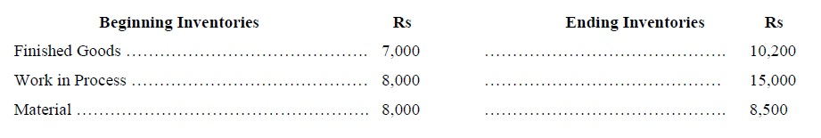

Slide 17
Cost of Goods Sold Statement
Solution:
ABC Co.
Cost of Goods Sold Statement For the Ended June, 2017
Gross Profit = Net Sales – CGS = 72,000 – 50,660 = Rs. 21,340
Net Profit =Gross Profit – All indirect expenses of office
= 21,340 – (72,000 *5%)-(72,000 *1%)-(72,000 *3%)
= 21,340 – 3,750 – 750 – 2,250
= Rs. 14,590
Per Unit Cost = Cost of goods manufactured / No. of Units Produced
= 53,860 / 5,000 = Rs. 11 per Unit

Slide 18
Beginning Inventory | 8,000
Net Purchases | 36,000
Direct Expense (36,000*1%) | 360
Material available for used | 44,360
Ending Inventory | 8,500
Material Used | 35,860
Direct Labor | 15,000
Prime Cost | 50,860
FOH (2/3 of 15,000) | 10,000
Total Factory Cost | 60,860
Work in Process beginning | 8,000
Cost of goods to be manufactured | 68,860
Work in Process Ending | (15,000)
Cost of goods manufactured | 53,860
Finished Goods Beginning | 7,000
Cost of goods available for sales | 60,860
Finished Goods Ending | (10,200)
Cost of Goods Sold | Rs. 50,660

